Slide 1

Exploratory Data Analysis
Project:- G2M insight for Cab Investment firm
Date:- 20-May-2022

Slide 2

Agenda
Executive Summary
Problem Statement
Approach
EDA
EDA Summary
Recommendations

Slide 3
Problem Statement:
XYZ is a private equity firm in US. Due to remarkable growth in the Cab Industry in last few years and multiple key players in the market, it is planning for an investment in Cab industry.
Provide actionable insights to help XYZ firm in identifying the right company for making investment.
Cab Companies:
Yellow Cab
Pink Cab
The Analysis include :
Data Understanding,
Data Visualization,
EDA.
Creating multiple hypothesis,

Slide 4
Data Preparation:
There are 4 datasets:
Cab_Data.csv – This file includes details of transaction for 2 cab companies.
Customer_ID.csv – This is a mapping table that contains a unique identifier which links the customer’s demographic details.
Transaction_ID.csv – This is a mapping table that contains transaction to customer mapping and payment mode.
City.csv – This file contains list of US cities, their population and number of cab users.

Slide 5
Exploratory Data Analysis

Slide 6
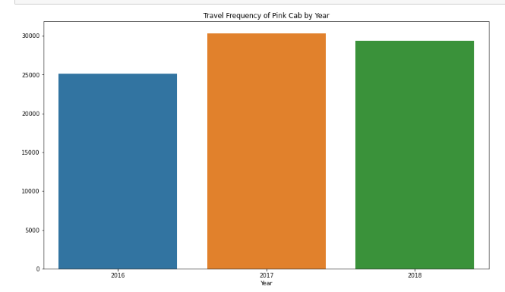
Travel Frequency of Pink Cab by Year
The Travel Frequency of Pink Cab is most in year 2017 which is approximately equal to 30000

Slide 7
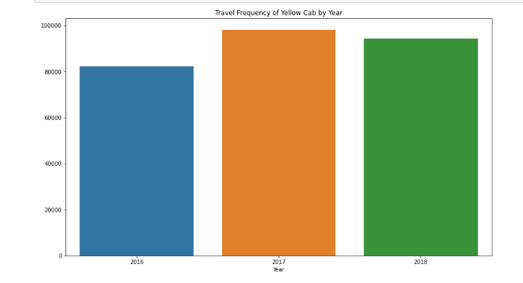
Travel Frequency of Yellow Cab by Year
The Travel Frequency of Yellow Cab is most in year 2017 which is approximately equal to 100000 .
It is also clear that People preferred Yellow Cab than Pink Cab .

Slide 8
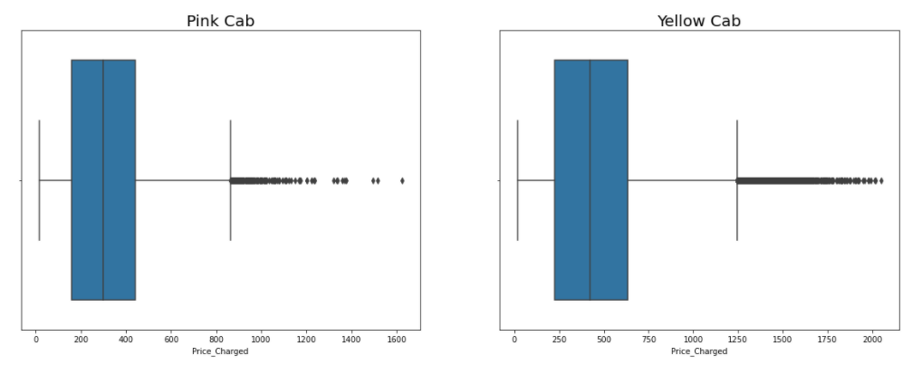
Distribution of Price Charged for both Cabs:
The Price Charge range for Yellow cab is more than the Pink cab.
The outliers are due to use of high-end cars.

Slide 9
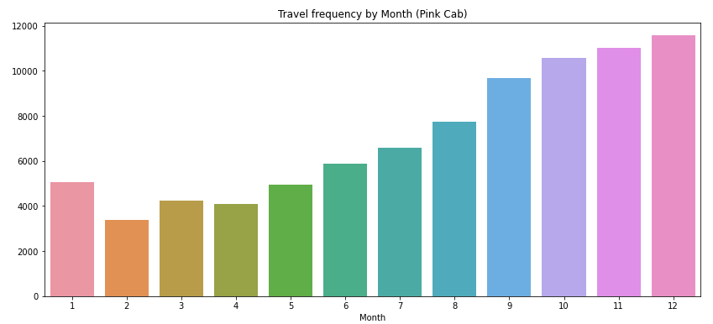
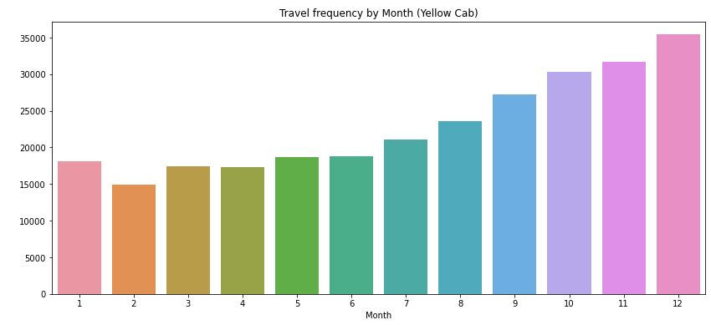
Travel Frequency Per Month:
Pin
In Holiday Session, Yellow Cab has higher travels (35000) compared to Pink Cab (11000). People preferred Yellow cab in holiday session.

Slide 10
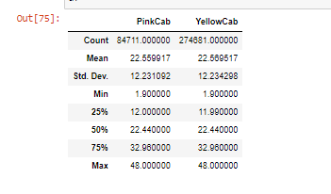
Maximum and Minimum KM Driven.
Both cabs were booked for maximum distance of 48Km and minimum distance of 2Km

Slide 11
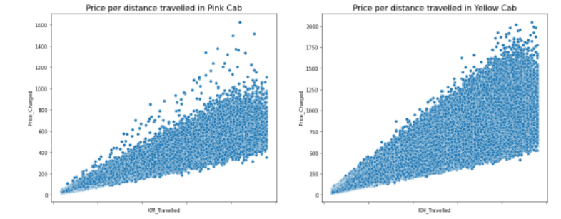
Price Per Distance Travelled
Pink Cab and Yellow Cab has Positive Correlation i.e. As Distance Increases Price Increases.

Slide 12
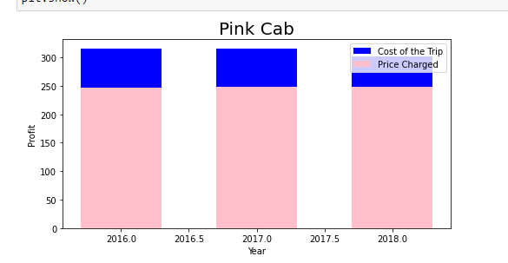
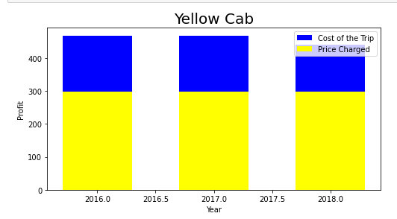
Profit Margin
The Yellow Cab has higher Profit Margin Compared to Pink Cab

Slide 13
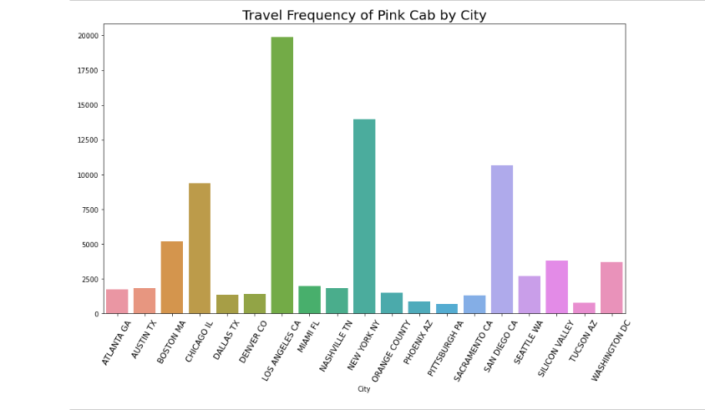
Travel Frequency of Pink Cab by City.
Pink Cab has highest travel frequency in LA

Slide 14
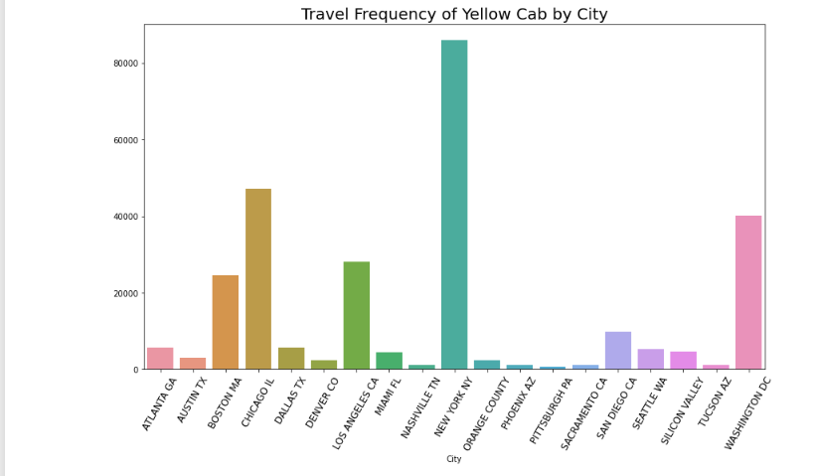
Travel Frequency of Pink Cab by City.
Pink Cab has highest travel frequency in NYC.

Slide 15
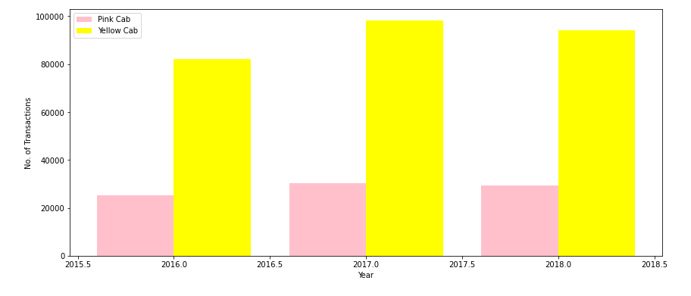
Transaction per Year for both Cabs:
From the graph it is clear that on yearly basis no. of transactions for Yellow cab is higher than Pink cab.

Slide 16
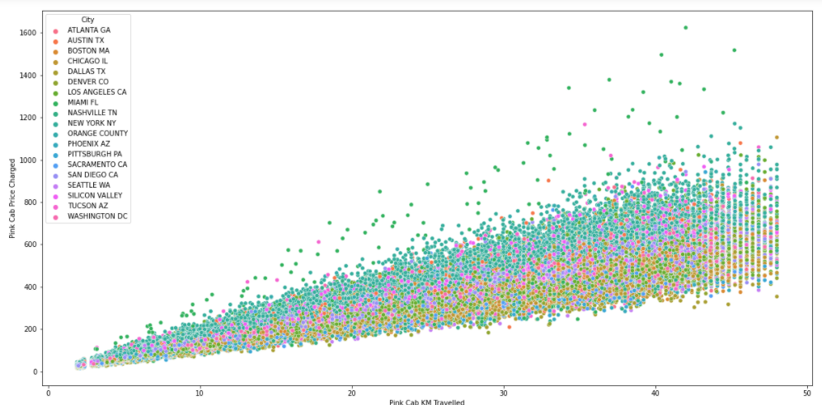
Price Charged Per City by Pink Cab
For Pink cab all the cities have the same increase in price charge with increase in distance

Slide 17
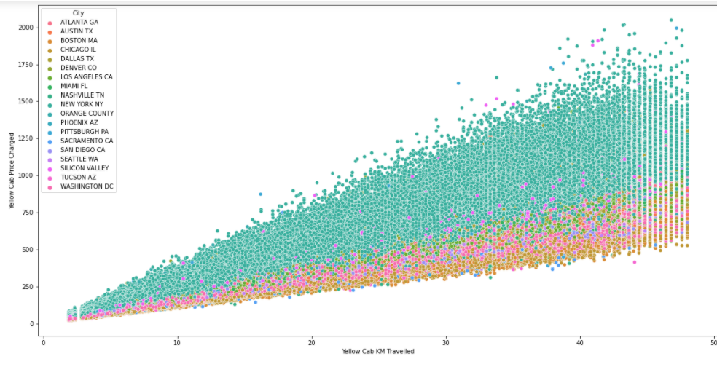
Price Charged Per City by Yellow Cab
In New York City the Price charged for Yellow Cab is more in comparison to the other cities

Slide 18
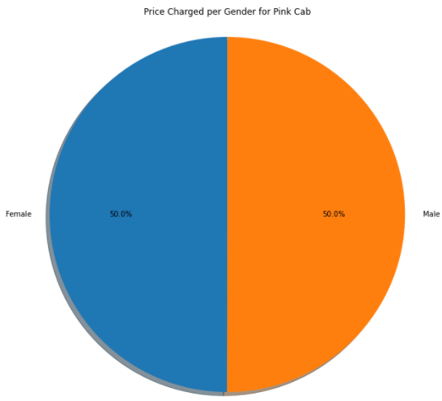
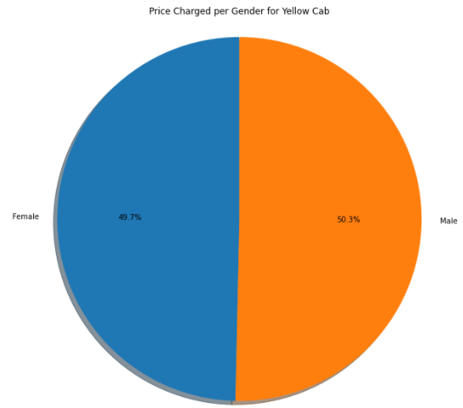
Price Charged per Gender for both Cabs:
Yellow Cab charge less from Female Customers whereas Pink Cab charges same for both Male and Female Customers.

Slide 19
Eda Summary

Slide 20
Pink Cab
Rides are in the range of approximately 2 to 48 KM.
Price Charge range from 150 to 450 dollars.
In holiday season, no. of travels was around 11000.
Transaction per year:
2016: 20000 – 40000
2017: 20000 – 40000
2018: 20000 – 40000
All the cities have the same increase in price charge with increase in distance
Pink Cab charges same for both Male and Female Customers
Profit Margin is low each year (2016-2018) compared to Yellow Cab.
Pink Cabs increase margins with increase in number of Transactions.
Yellow Cab
Rides are in the range of approximately 2 to 48 KM.
Price Charge range from 250 to 600 dollars.
In holiday season, no. of travels was around 35000
Transaction per year:
2016: 80000 – 100000
2017: 80000 – 100000
2018: 80000 – 100000
In New York City the Price charged for Yellow Cab is more in comparison to the other cities.
Yellow Cab charge less from Female Customers
Profit Margin is high each year (2016-2018) compared to Pink Cab.
Yellow Cab decrease Margins with the increase in Transaction

Slide 21
Hypothesis Testing

Slide 22
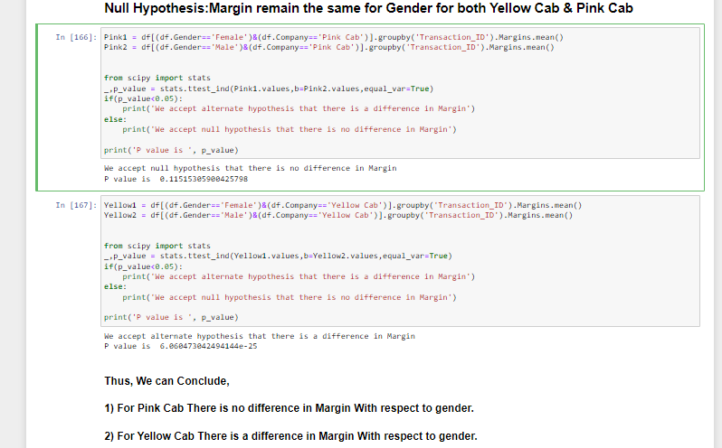
Null Hypothesis: Margin remain the same for Gender for both Yellow Cab & Pink Cab

Slide 23
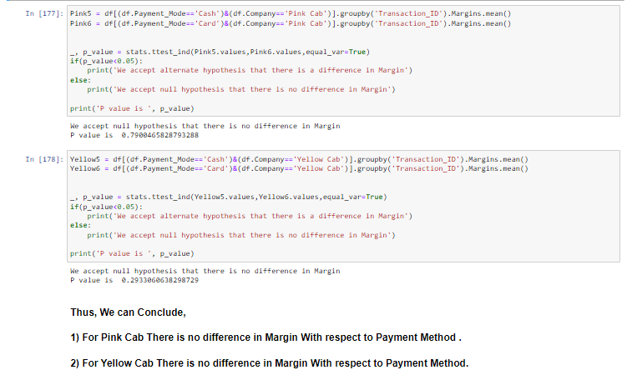
Null Hypothesis: There is no difference in Margin with respect to Payment Method

Slide 24
Recommendation
Margin per Gender: For Yellow Cab there is difference in Margin between Male and Female Customers due to which Female Customer percentage is higher in Yellow Cab in comparison to Pink Cab.
Profit Margin: For Yellow Cab the Profit Margin is higher per year from 2016 to 2018 in comparison to Pink Cab.
Margin per Age: In Yellow Cab there is difference in Margin for people older than 50 yrs, whereas in Pink Cab there is no difference in Margin of all age group.
Yellow Cab decreases Margins with the increase in Transaction, hence for Yellow Cab the travel frequency during the Month of December which is the holiday season is 3 times more than Pink Cab.
Transaction per year: For Yellow Cab Transaction per year from 2016 to 2018 is almost double than Pink Cab
Customers for Yellow Cab is highest in New York City which has the highest Cab Users of 28%.

Slide 25
Based on above recommendation It is advised to Invest in Yellow Cab.

Slide 26
Thank You

